Slide 1

Influence of Diets on the Gut Microbiome in the Context of C. difficle Infection
Madi Apgar

Slide 2
Experimental Background

Slide 3
Plots/Stats

Slide 5
Notes:
- Mouse death might be due to the mice on the western diet not being able to control bacterial growth after compromise and c. diff infection – death is caused by secondary infection by gram negative organisms and/or gut barrier compromise and systemic infection and death

Slide 8
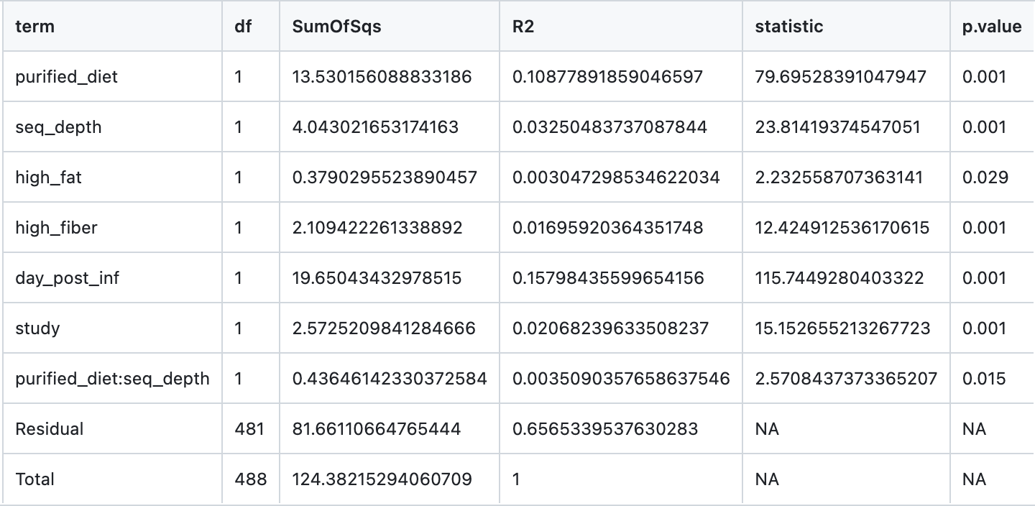
Unweighted UniFrac PcoA Adonis Test Results
Notes:
Unweighted unifrac stats

Slide 10
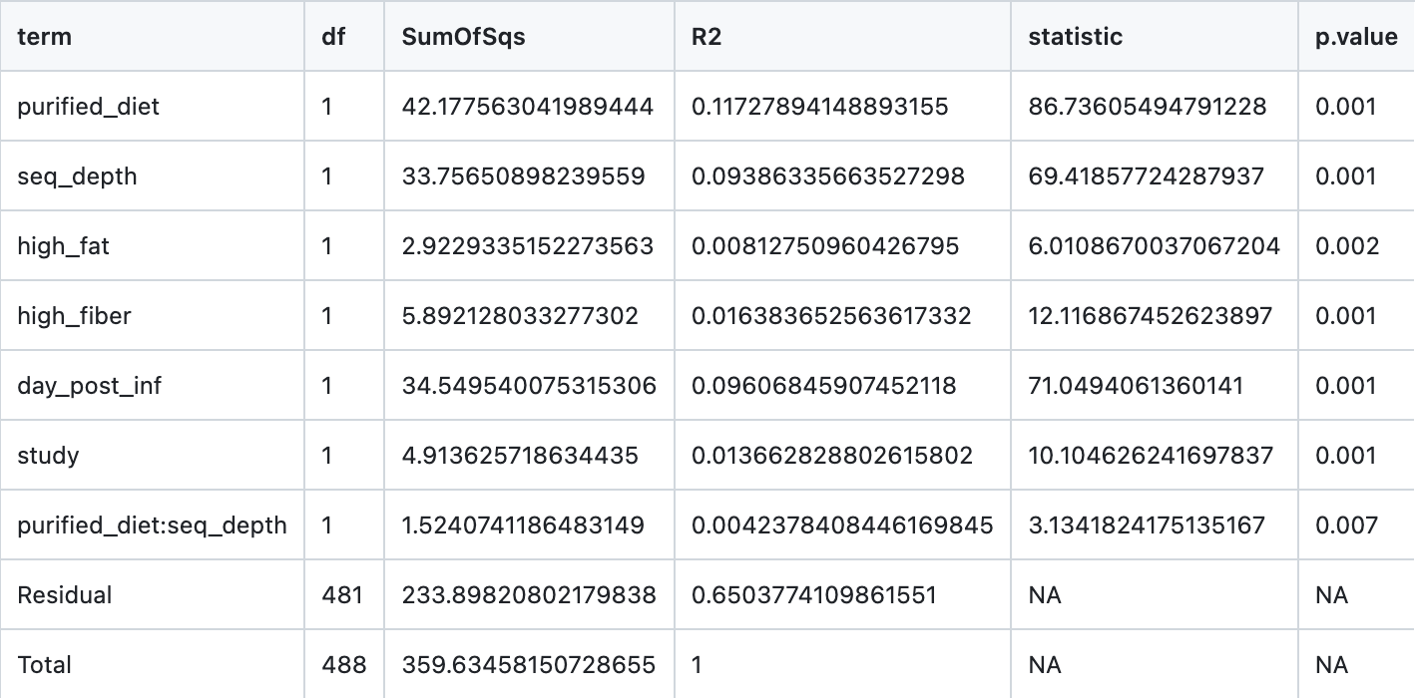
Weighted UniFrac PcoA Adonis Test Results
Notes:
Weighted unifrac stats

Slide 12
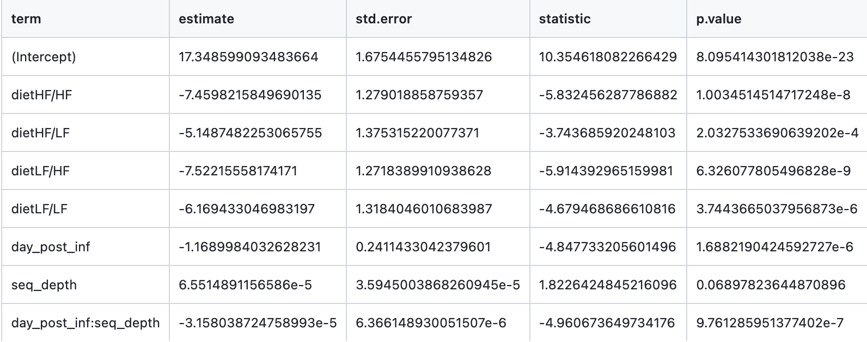
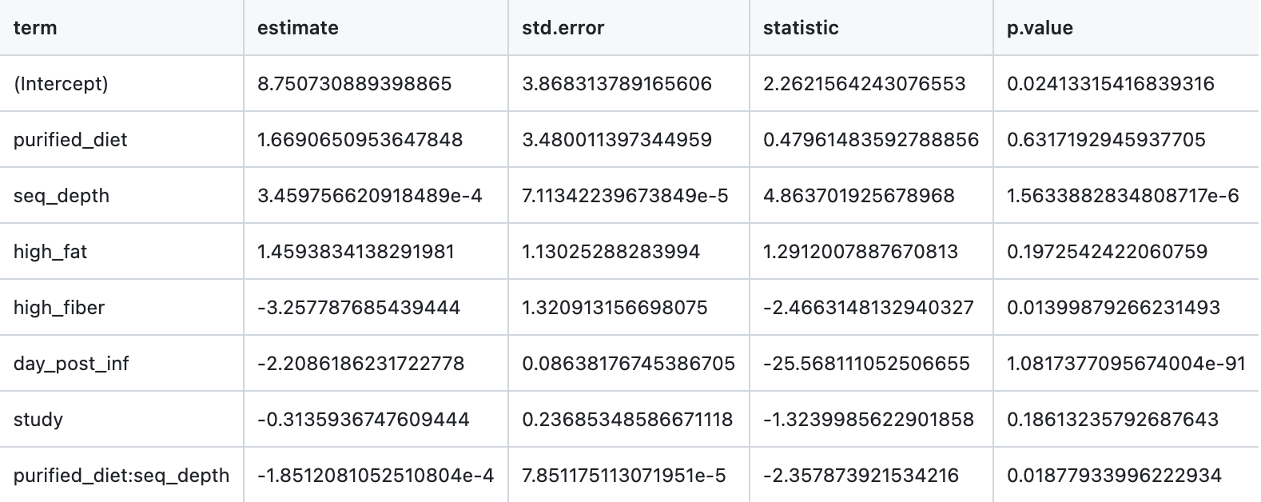
Faith’s Phylogenic Diversity Linear Model Results
*overall diet linear model
*diets sectioned by fat/fiber content linear model

Slide 14
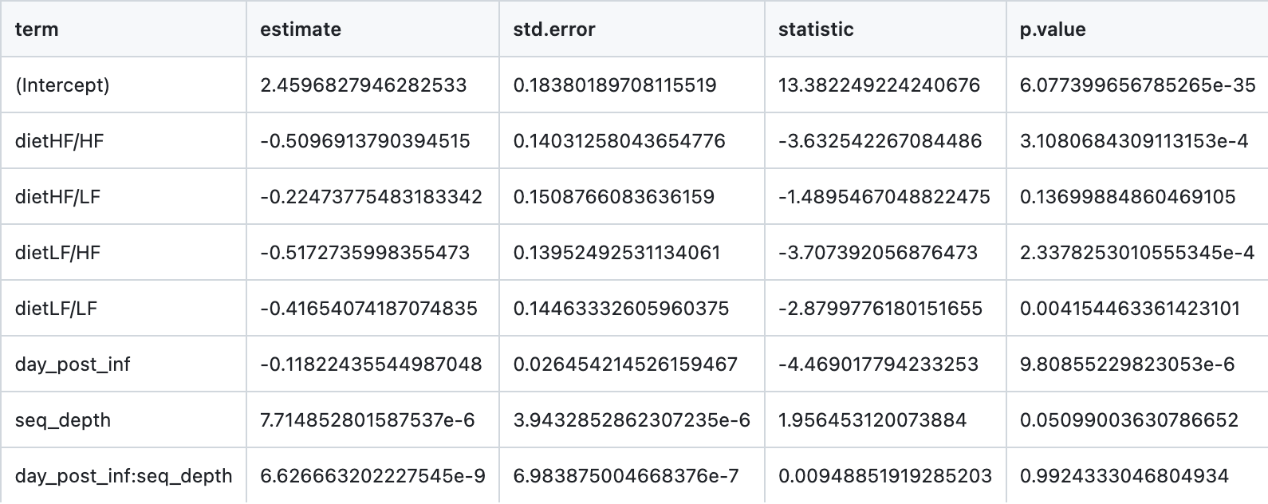
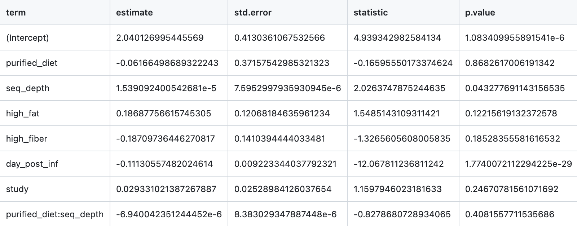
Shannon Entropy Linear Model Results
*overall diet linear model
*diets sectioned by fat/fiber content linear model

Slide 15
Notes:
Unweighted unifrac

Slide 16
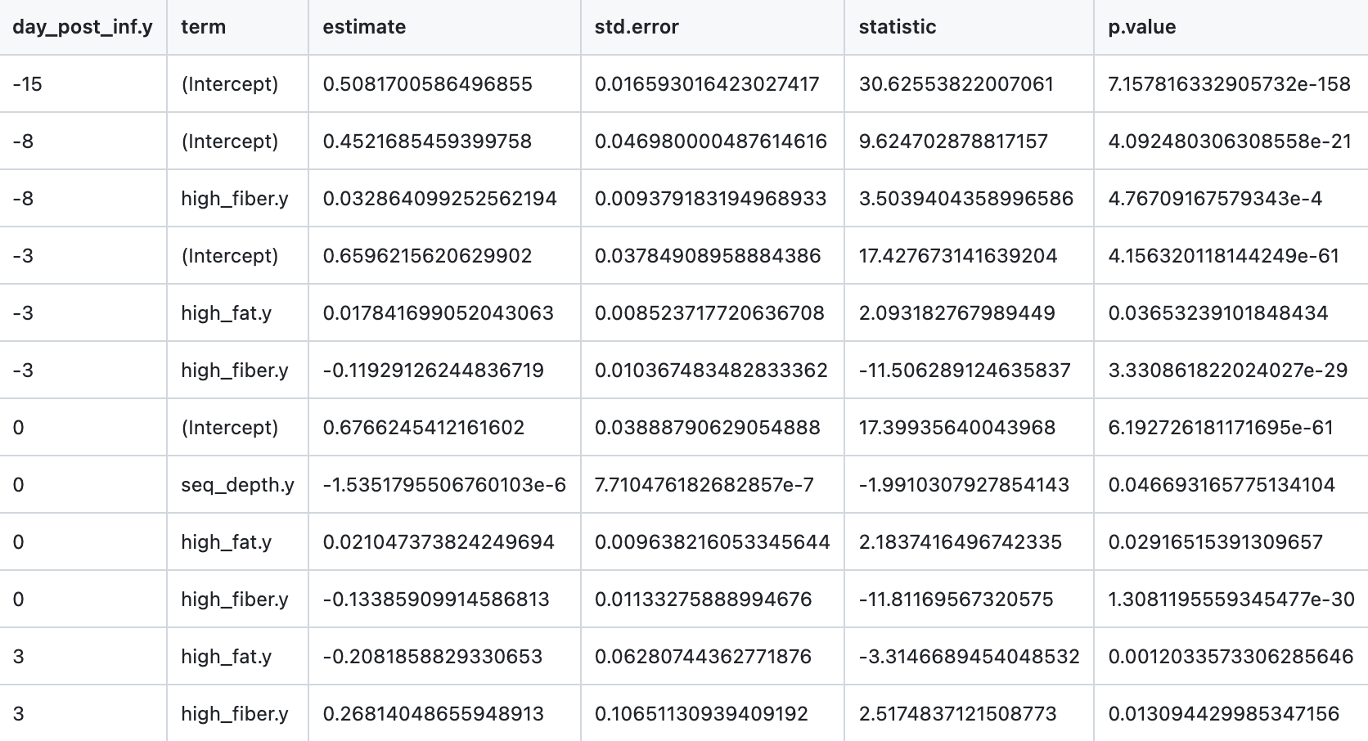
Unweighted UniFrac Homogeneity Linear Model Results

Slide 17
Notes:
Unweighted unifrac

Slide 18
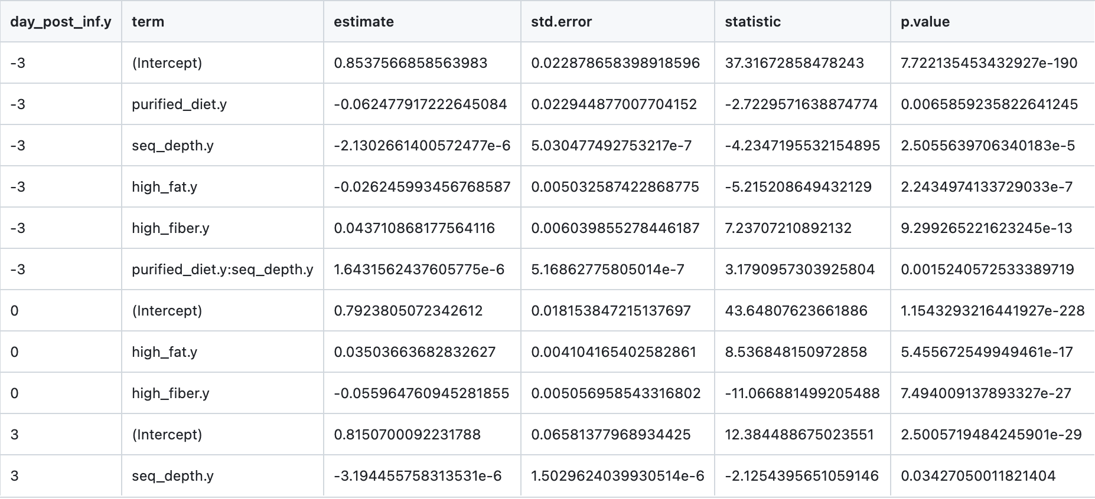
Unweighted UniFrac Resiliency Linear Model Results

Slide 19
Notes:
Weighted unifrac

Slide 20
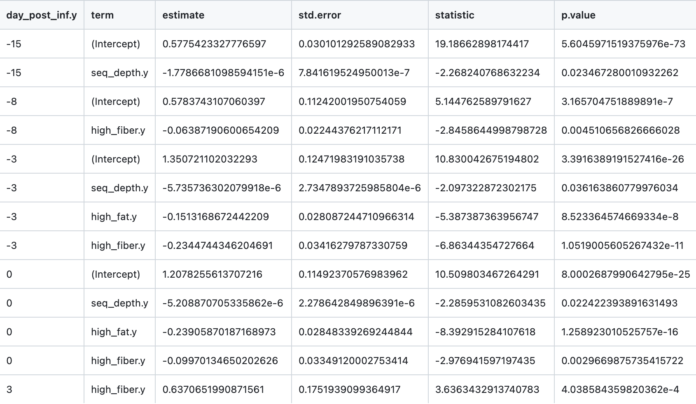
Weighted UniFrac Homogeneity Linear Model Results

Slide 21
Notes:
Weighted unifrac

Slide 22
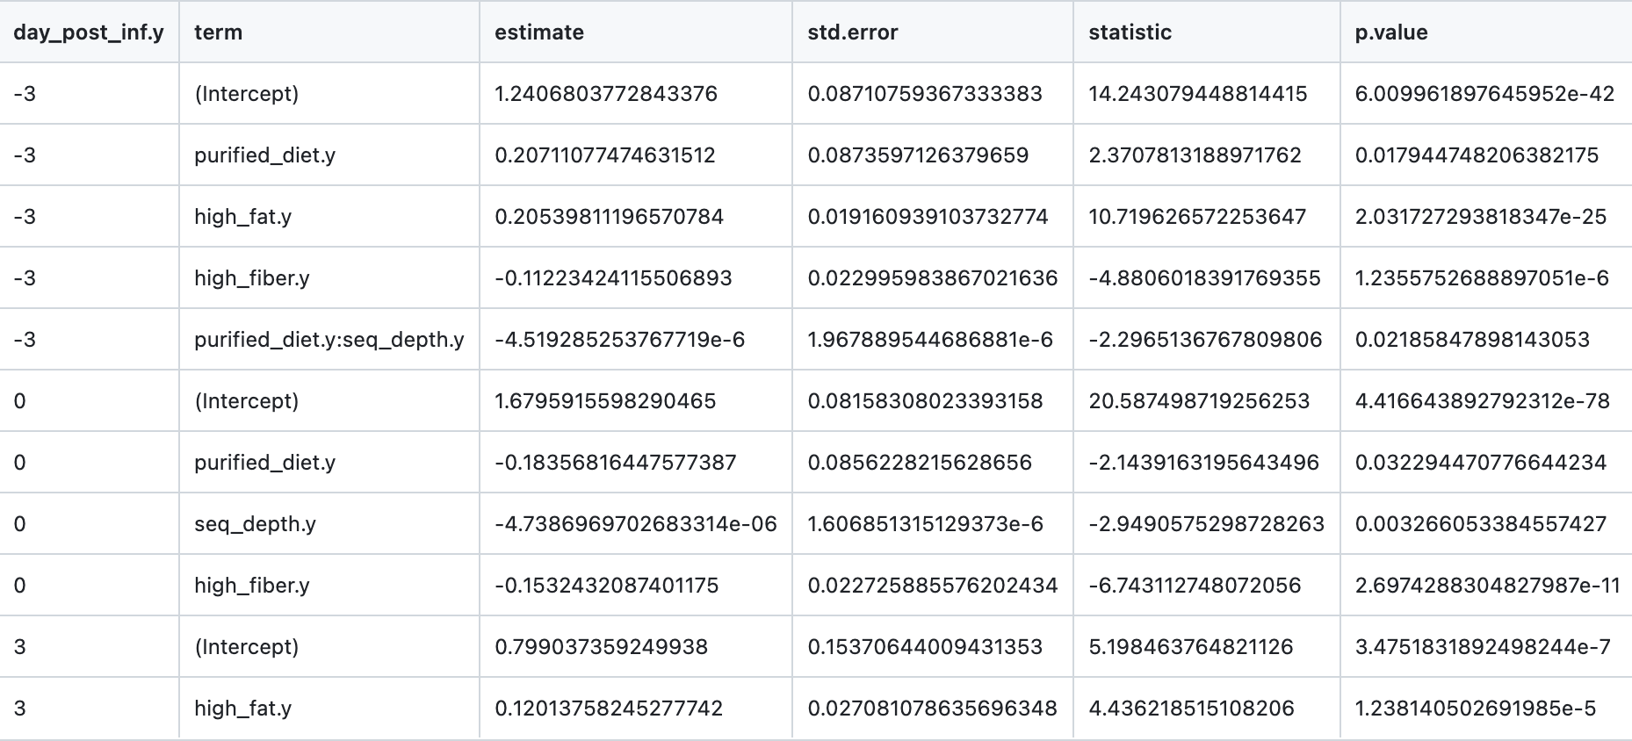
Weighted UniFrac Resiliency Linear Model Results

Slide 23
Plots/Stats in Progress

Slide 24
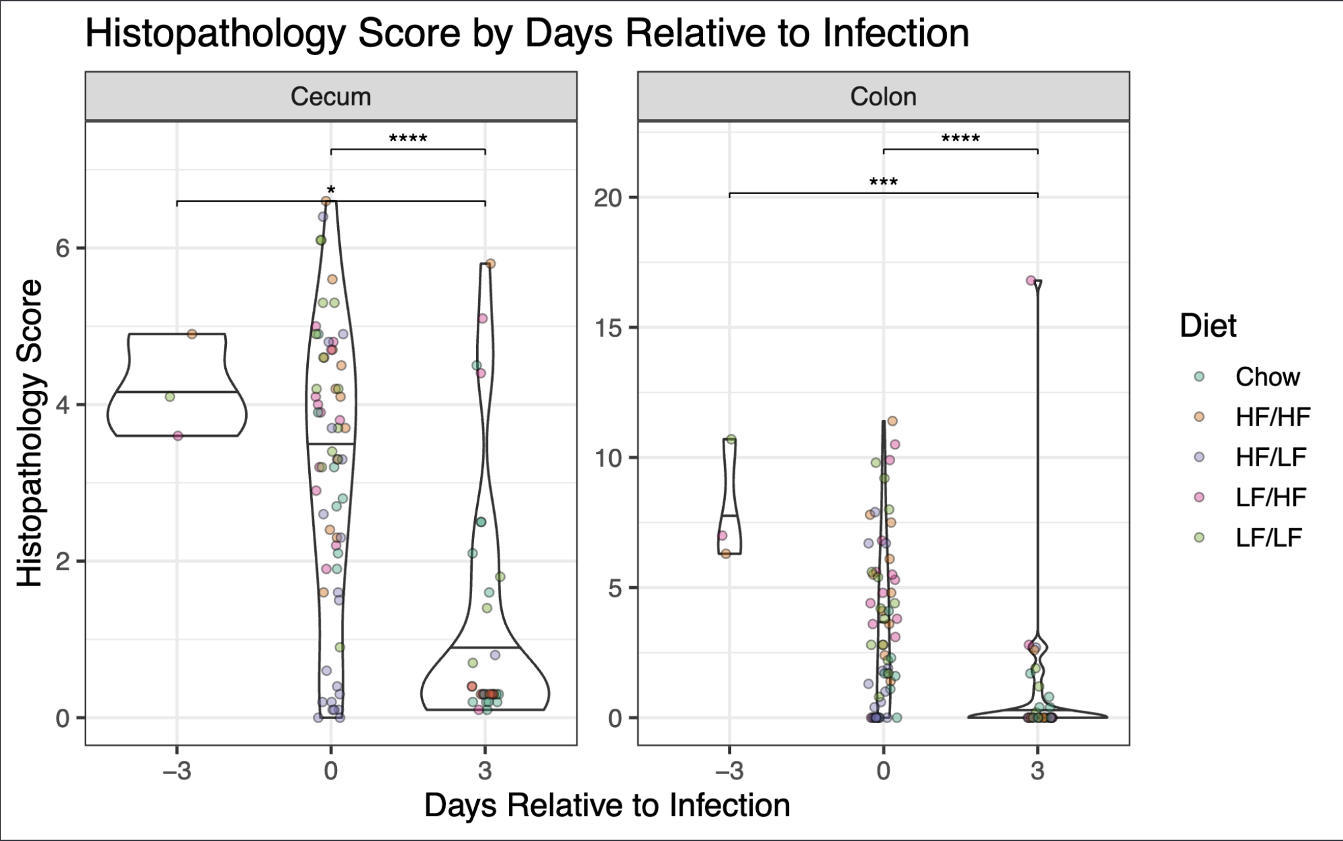
Notes:
Plot cecum and colon against each other and look for correlation (x and y axes)
Compare toxin concentration and histopathology score
All histopathology scores are from mice at day 3, this doesn’t totally match up with the 16S metadata since day 3 poop samples were not collected for some of the mice and weren’t included in 16S data

Slide 25
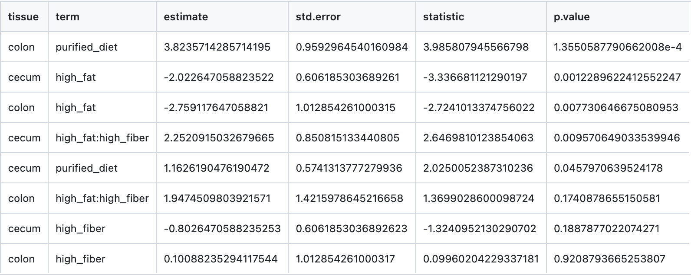
Histopathology Linear Model Results

Slide 26
Notes:
Possibly take out 2-methyl-butanoic/propanoic acids, isopentanoic acid, pentanoic acid etc since they’re not entirely relevant - focus on the remaining metabolites only
Compare metabolite concentration to histopathology score

Slide 27

Short Chain Fatty Acid (Metabolomic) Linear Model Results

Slide 28
Notes:
- The two toxins are highly co-correlated this is contrary to what we’ve seen before

Slide 29
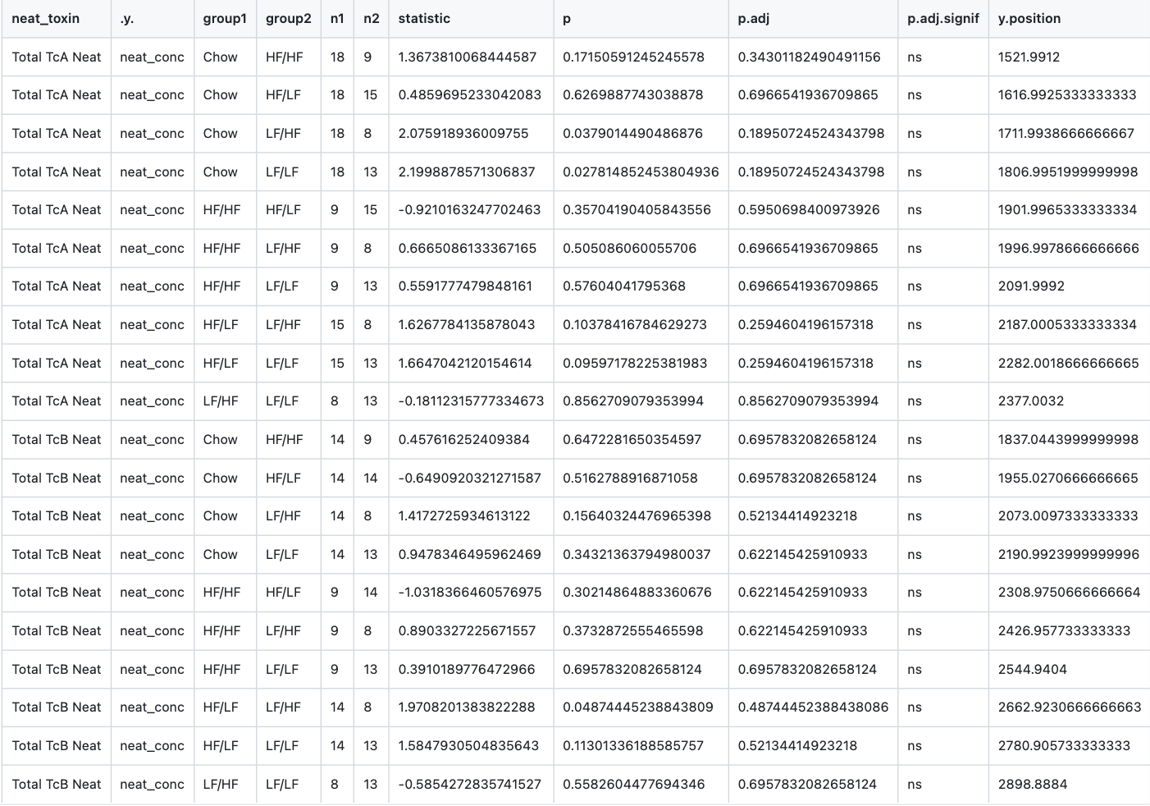
Neat Toxin Concentration Dunn’s Post Hoc Test Results

Slide 31
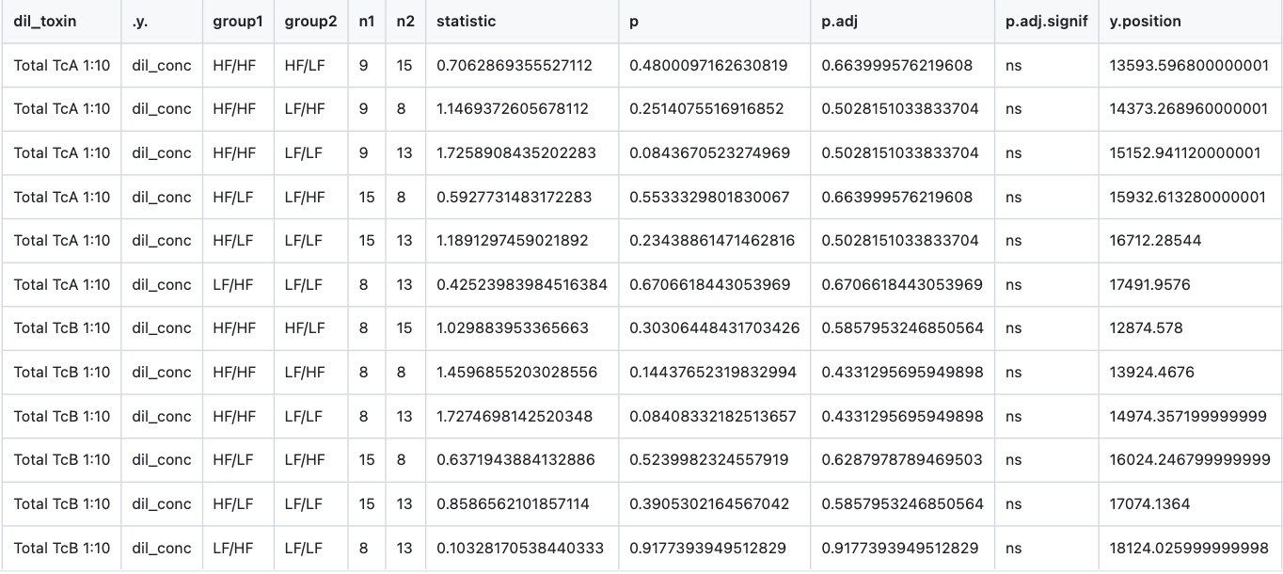
Diluted Toxin (1:10) Concentration Dunn’s Post Hoc Test Results

